Slide 1
Models of Network Barabási-Albert Model
MA 653: Network Science
Instructor: Ashok Singh Sairam
ashok@iitg.ac.in

Slide 2
Acknowledgement
Slides have been heavily borrowed from Prof. Konstantinos Pelechrinis, School of Information Sciences, University of Pittsburgh

Slide 3
Price Model – Computer Simulation
Based on Price model the probability that an outgoing edge attaches to vertex i is:
Let’s consider a slightly different process with which we do the following:
With probability φ we attach the edge to a vertex chosen strictly in proportion to its current in-degree:
With probability 1-φ, we attach the edge to a vertex chosen uniformly at random from all n nodes, that is, the probability for each vertex getting the edge is 1/n

Slide 4
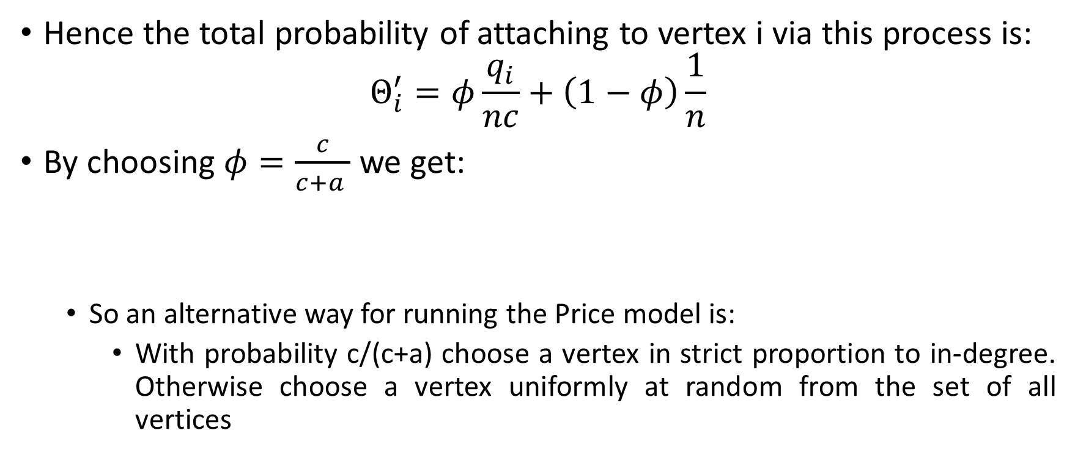
Hence the total probability of attaching to vertex i via this process is:
$$Θ_{i}^{′}=φ\frac{q_{i}}{nc}+\left(1−φ\right)\frac{1}{n}$$
By choosing $φ=\frac{c}{c+a }$ we get:
So an alternative way for running the Price model is:
With probability c/(c+a) choose a vertex in strict proportion to in-degree. Otherwise choose a vertex uniformly at random from the set of all vertices

Slide 5
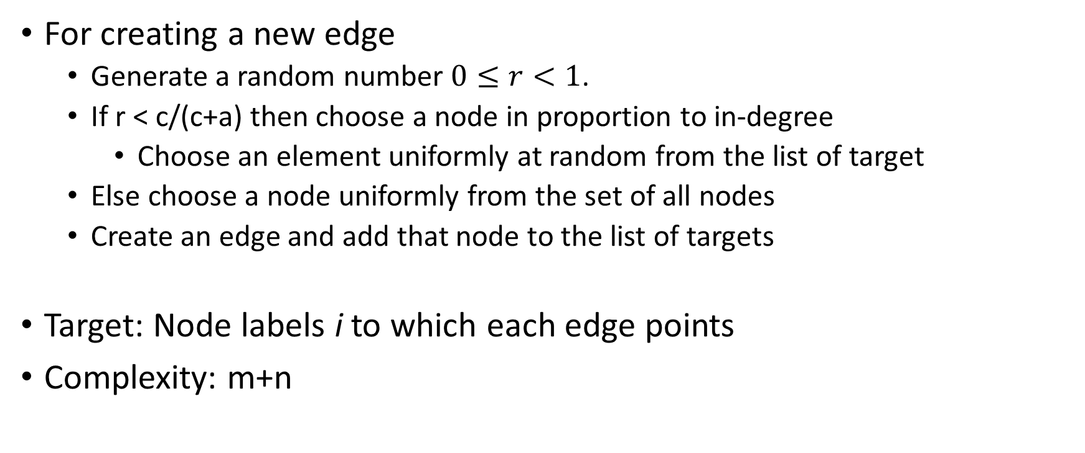
Price model: algorithm
For creating a new edge
Generate a random number $0≤r<1$.
If r < c/(c+a) then choose a node in proportion to in-degree
Choose an element uniformly at random from the list of target
Else choose a node uniformly from the set of all nodes
Create an edge and add that node to the list of targets
Target: Node labels i to which each edge points
Complexity: m+n

Slide 6
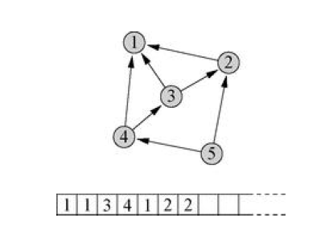
Example: Price model implementation
In this example, there are three edges that point to vertex 1 and hence there are three elements containing the number 1 in the list, and so on.

Slide 7
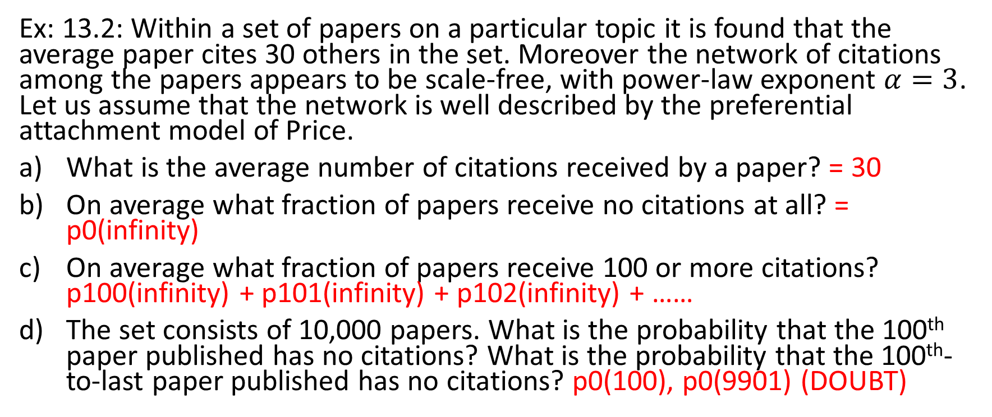
Exercise
Ex: 13.2: Within a set of papers on a particular topic it is found that the average paper cites 30 others in the set. Moreover the network of citations among the papers appears to be scale-free, with power-law exponent $α=3$. Let us assume that the network is well described by the preferential attachment model of Price.
What is the average number of citations received by a paper? = 30
On average what fraction of papers receive no citations at all? = p0(infinity)
On average what fraction of papers receive 100 or more citations? p100(infinity) + p101(infinity) + p102(infinity) + ……
The set consists of 10,000 papers. What is the probability that the 100th paper published has no citations? What is the probability that the 100th-to-last paper published has no citations? p0(100), p0(9901) (DOUBT)

Slide 8
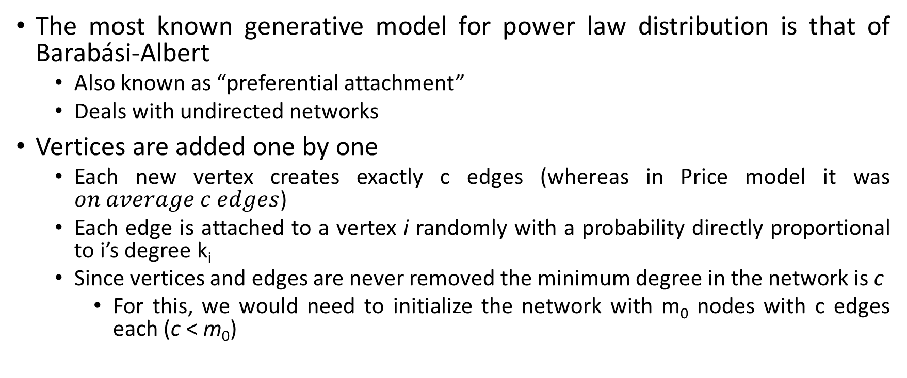
Barabási-Albert Model
The most known generative model for power law distribution is that of Barabási-Albert
Also known as “preferential attachment”
Deals with undirected networks
Vertices are added one by one
Each new vertex creates exactly c edges (whereas in Price model it was $on average c edges$)
Each edge is attached to a vertex i randomly with a probability directly proportional to i’s degree k_{i}
Since vertices and edges are never removed the minimum degree in the network is c
For this, we would need to initialize the network with m₀ nodes with c edges each (c < m₀)

Slide 9
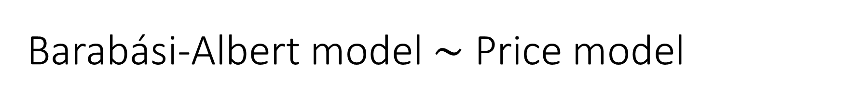
Barabási-Albert model$\sim$ Price model
Barabási-Albert (BA) model is a special case of Price model
Let’s assume that each edge has a direction from the newly created vertex to the old vertex chosen to be attached
The out-degree of every vertex is exactly c
The total/undirected degree of vertex i is then k_{i}=q_{i}+c, where q_{i} are the edges that point to i
Given that the probability in the BA of an edge attaching to a node is simply proportional to k_{i}, this means that it is proportional to q_{i}+c
This is the Price model with a = c

Slide 10
Barabási-Albert Model
Hence the distribution of the in-degree for this “directed” version of the BA networks is:
Substituting q+c with k we get the degree distribution for the undirected BA network:
In the limit of large k, p_{k}~k⁻³
Power law with exponent α=3

Slide 11
Barabási-Albert Model: Summary
BA model is
Simple – no requirement for setting parameter a
Degree distribution can be expressed without the need of beta or gamma functions
However it comes with the price of being able to create power law degree distribution with only one exponent (α=3)

